Slide 1

The Aga Khan Hospital Dar es Salaam
Dr. Aidan Tumaini Njau - OPA Documentation Compliance for Q4 2022

Slide 2
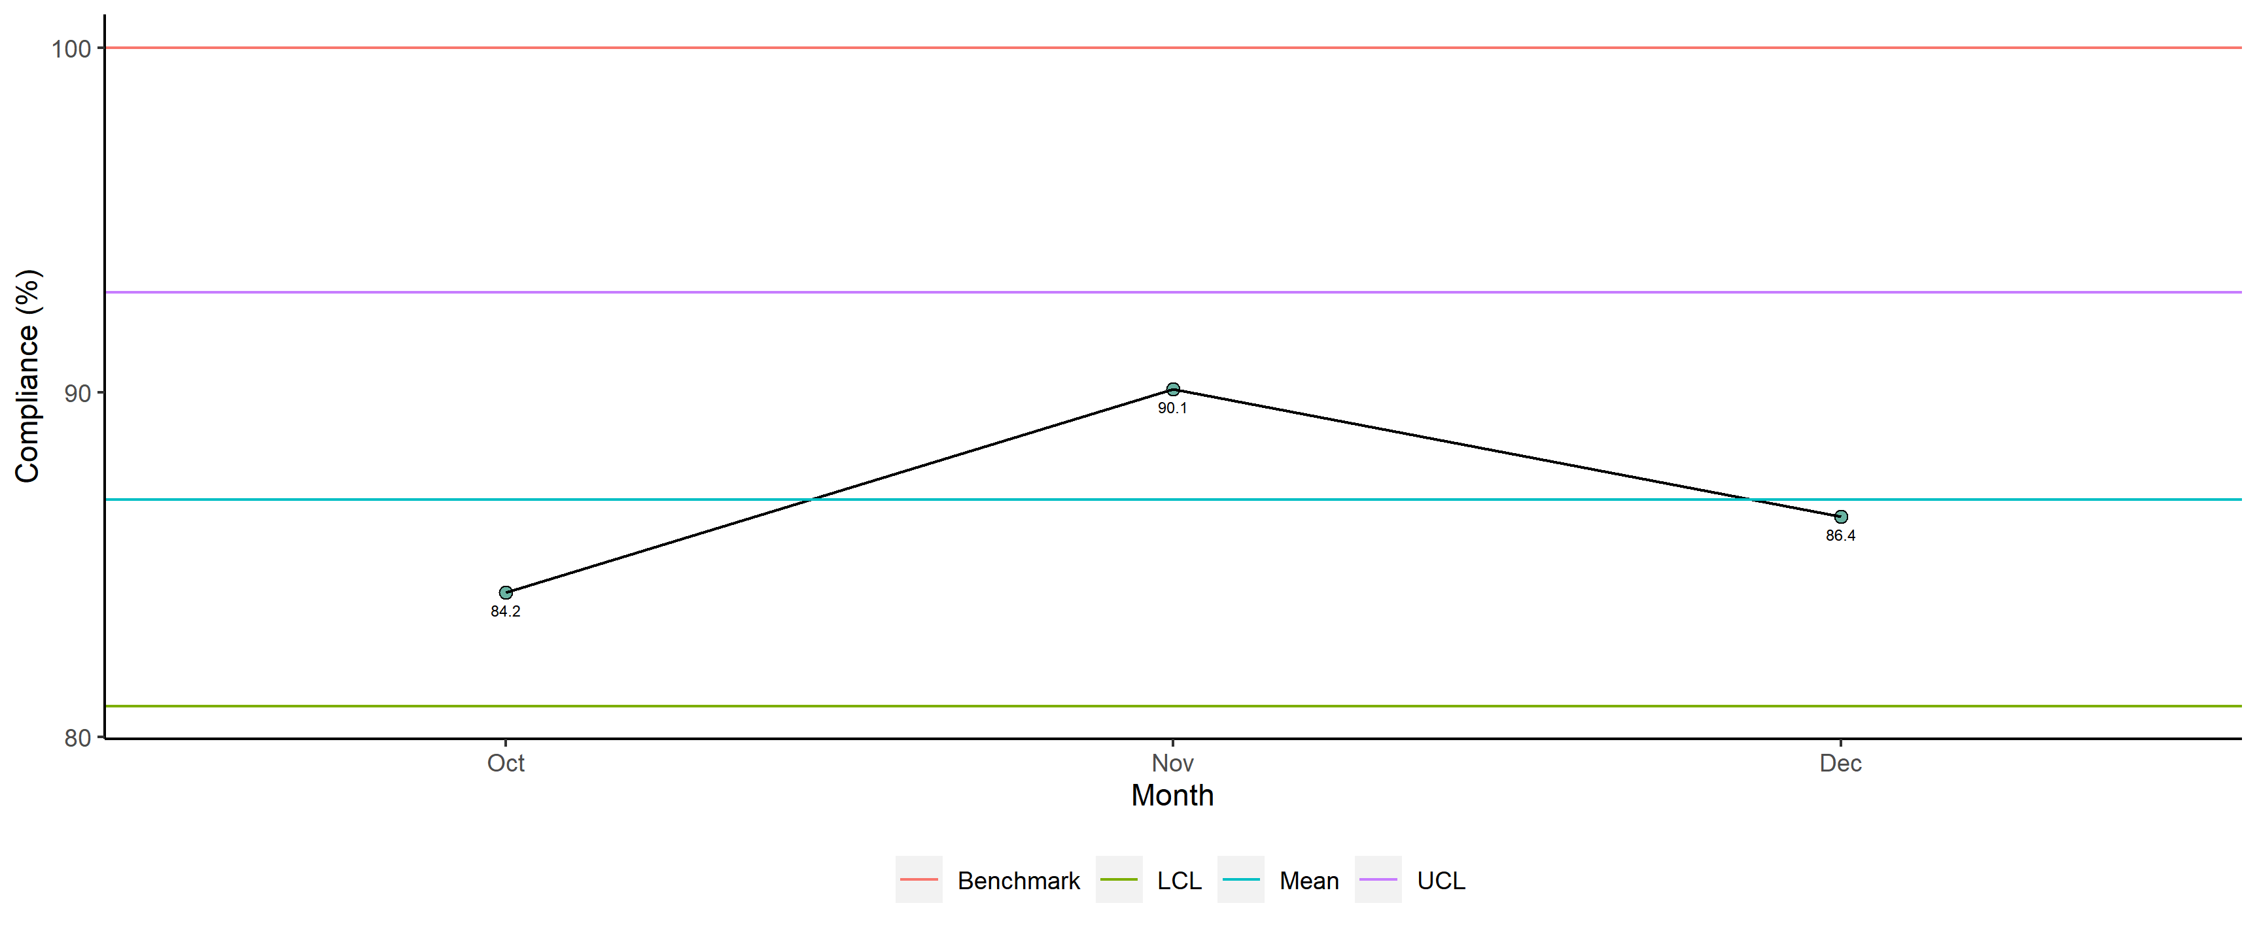
Dr. Aidan Tumaini Njau - Availability of Required Documents

Slide 3
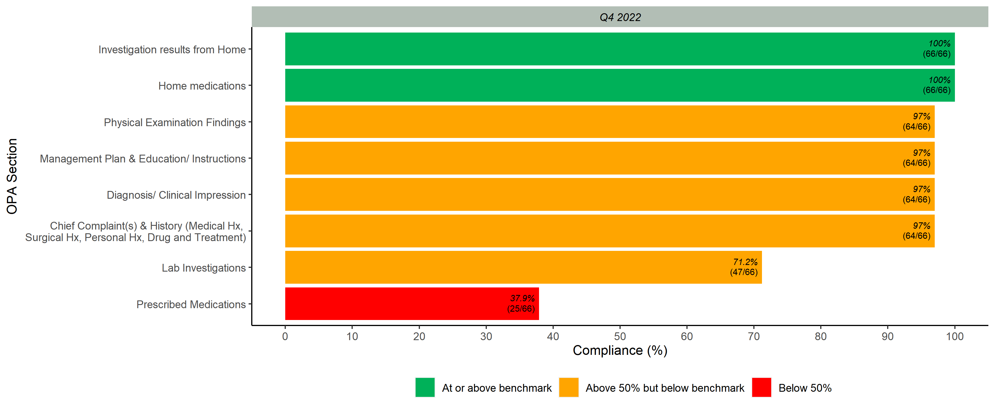
Documented Scores per OPA Section

Slide 4
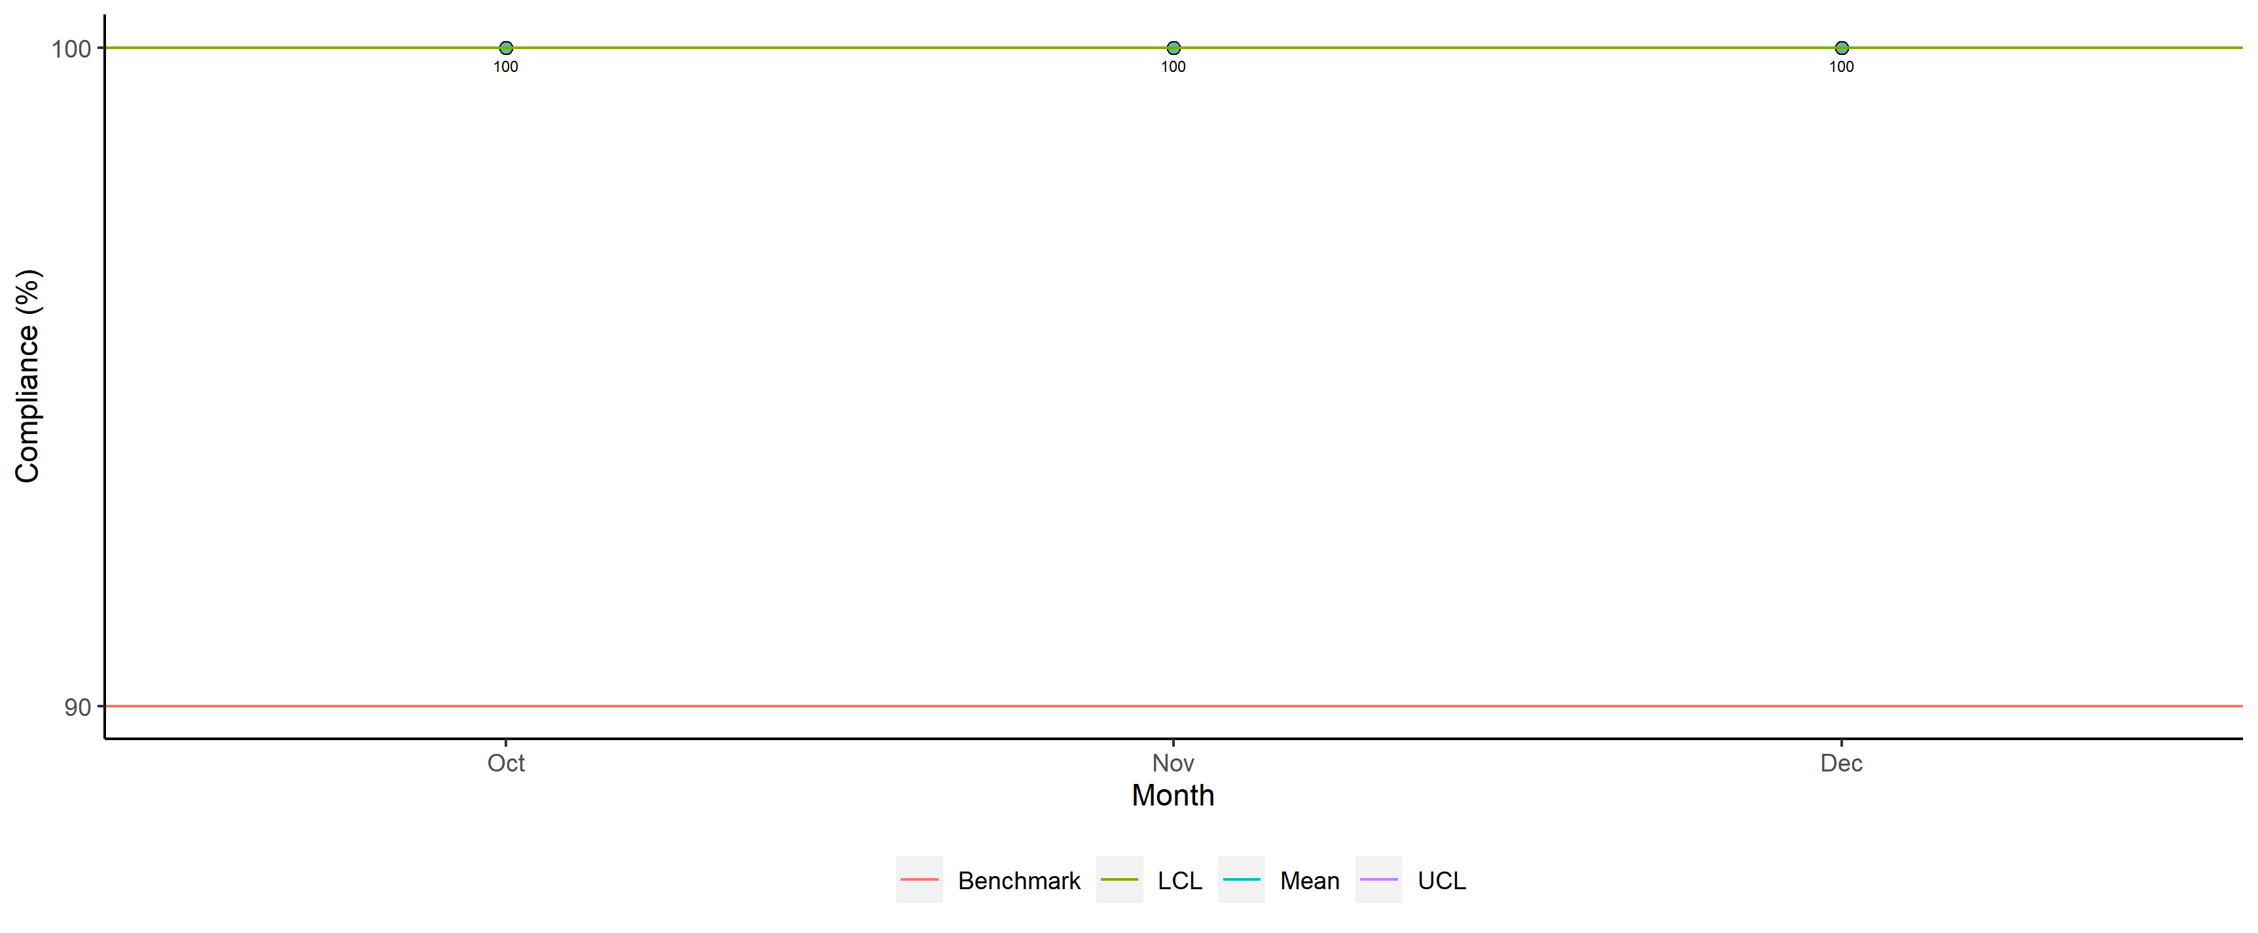
Dr. Aidan Tumaini Njau - Legibility

Slide 5
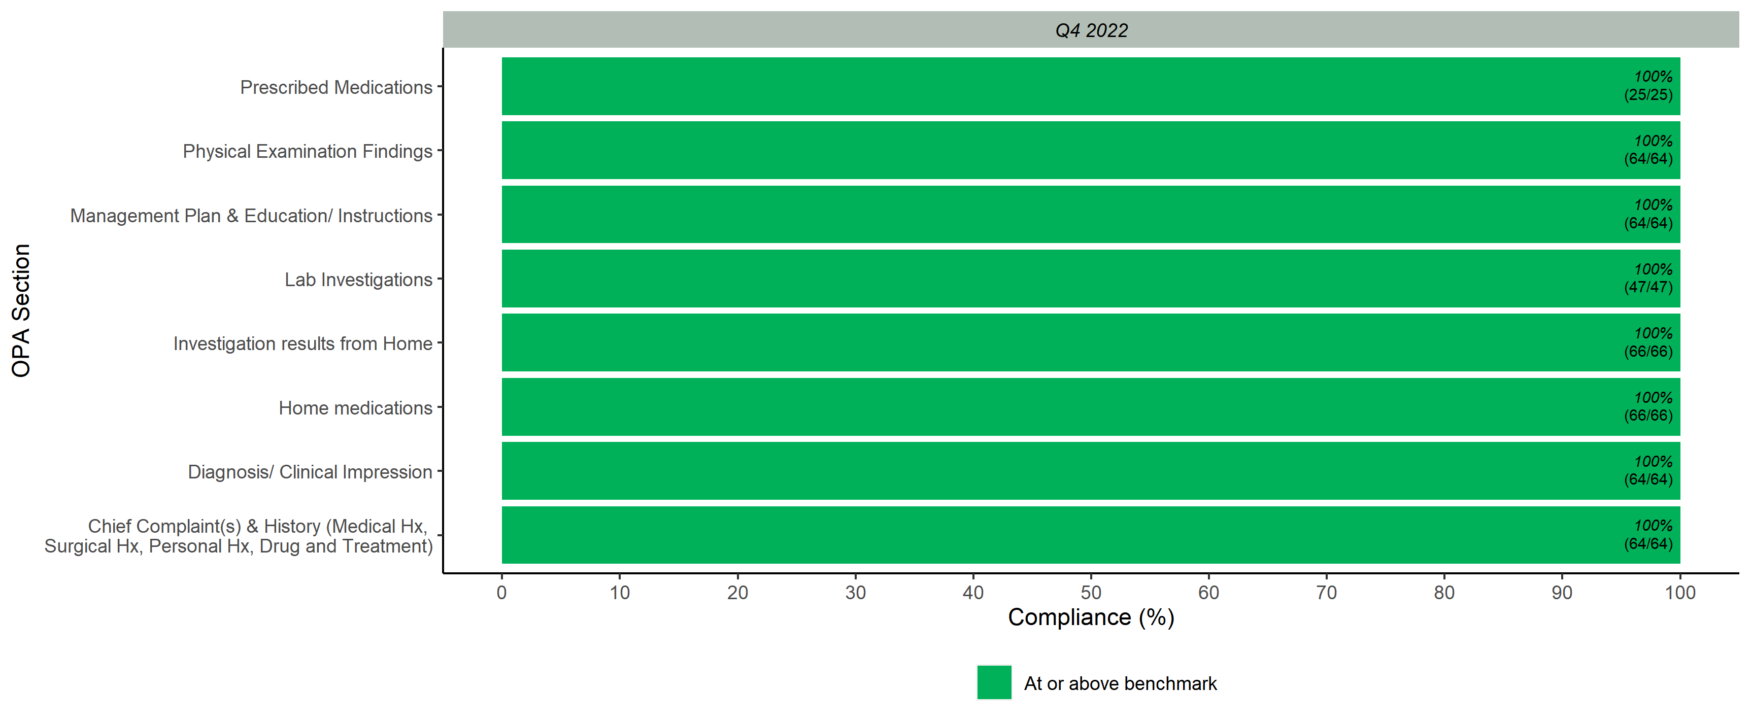
Legibility Scores per OPA Section

Slide 6
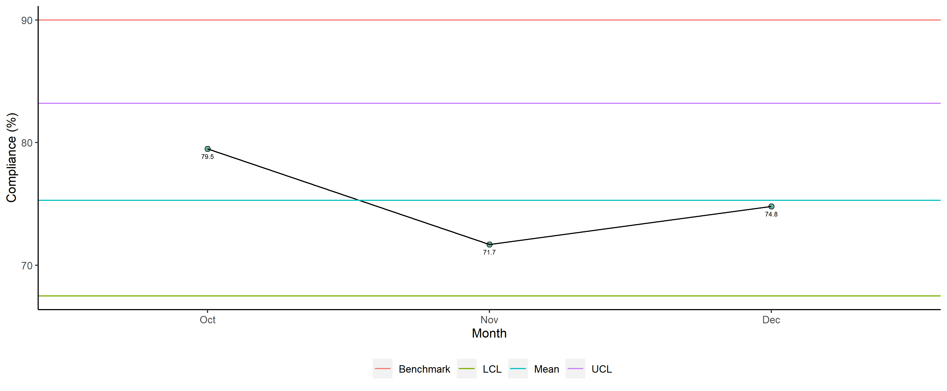
Dr. Aidan Tumaini Njau - Completeness

Slide 7
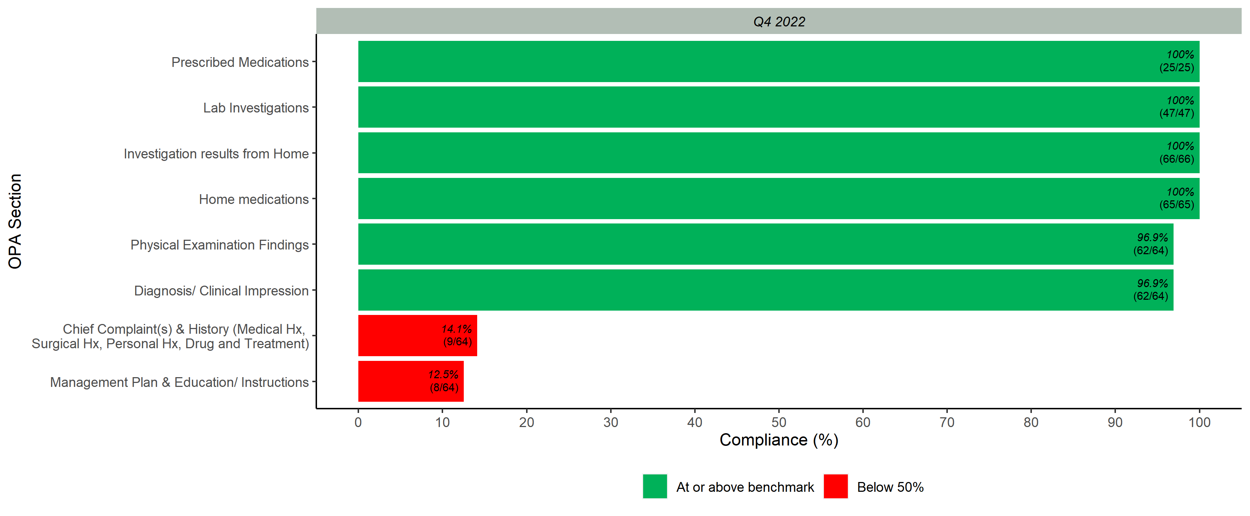
Completeness Scores per OPA Section

Slide 8
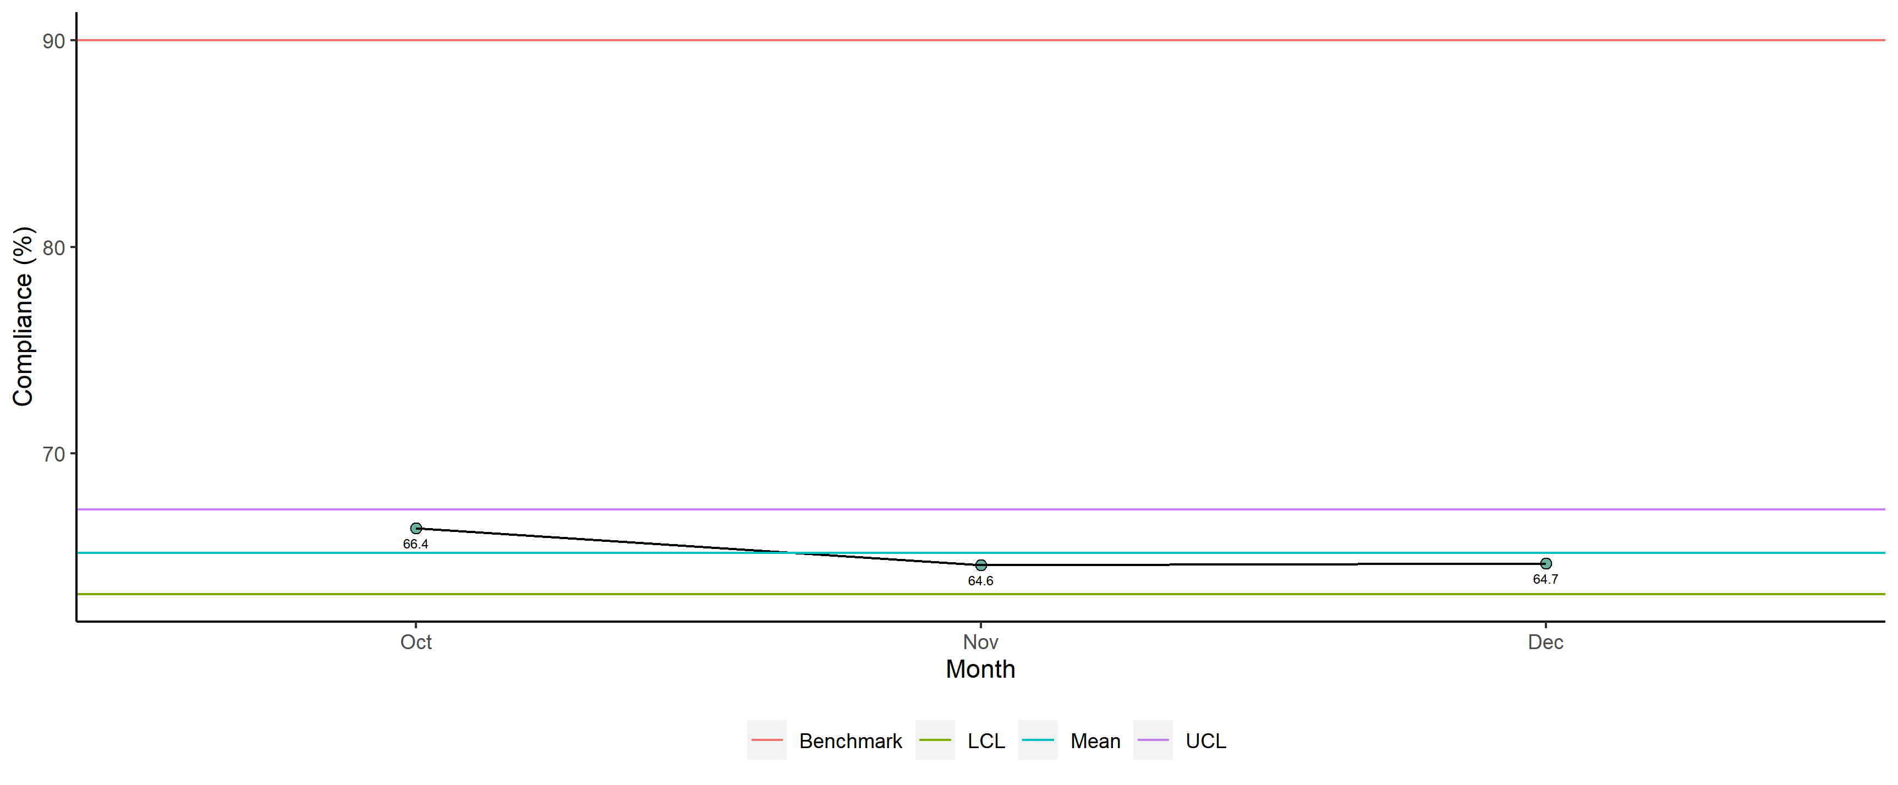
Dr. Aidan Tumaini Njau - Overall

Slide 9
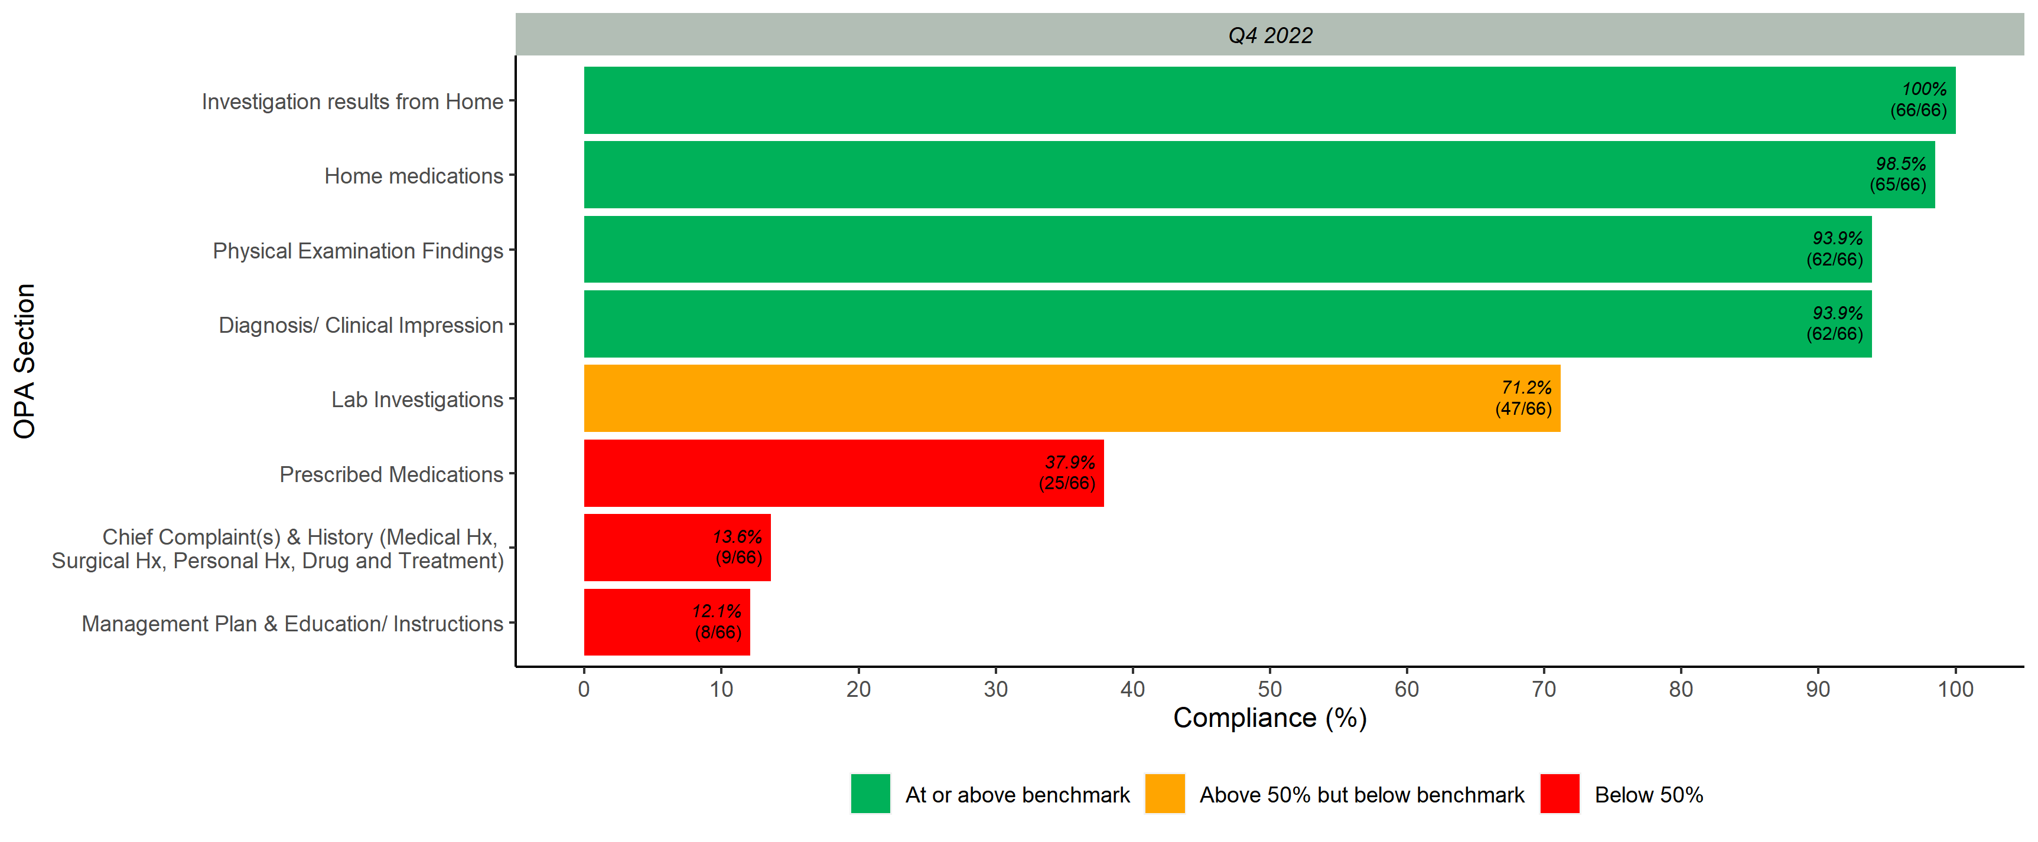
Overall Scores per OPA Section

